Slide 1

Cell 2 Cell
Churn Model
Final Presentation
Group C
Nguyet Minh Chu
Omar Youssef
Zachary Hunter
Zixuan Wu

Slide 2
Introduction
Cell2Cell is the 6th largest wireless company in the US, giving service to nearly 10 million subscribers, serving more than 210 metropolitan markets & 2900 cities (covering nearly all 50 states). The company is currently facing a major problem of customer churn.
We are using R to develop a model for predicting customer churn at Cell2Cell.
Business Objectives:
Decrease the churn rate and improve on customer retention
Increase profitability
Identify business incentives for keeping customers with a high risk of churning

Slide 3
Overview
To predict the factors that will contribute to churn we decided to use 4 models:
Model | Time Spent in Analysis | Strengths & Weaknesses
Logistic Regression | 1 hour in R | Show clear relationship between the predictable variable and dependent variables Accuracy is relatively low
Naive Bayes | 1 hour in R | Easy to implement and don’t have to worry much about overfitting (more likely to underfit) NB might not work as well if there are features that are dependent on one another. The variables with the highest correlation to churn that we built the model with does seem to have dependent features such as MOU and RECCHRGE which may have affected the performance
Decision Tree | 2 hours in R | Very helpful for making decisions on how each variables affect the churn rate The relationship between one on one variables are not clear thus affecting the accuracy of predicting the churn rate
GBM | 3 hours in R | Provides predictive accuracy and lots of flexibility with pre-tuning options Provides relative influence data amongst variables in model to show strength of variable in predicting churn

Slide 4
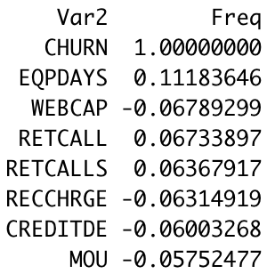
Data Preparation
Original dataset began with:
40,000
Customers in Calibration Data
31,047
Customers in Validation Data
78
Total Variables
Conducted analysis in R to focus on highest correlated variables with a frequency of abs(>.05):
7 Highest correlation variables are:
EQPDAYS: # of days of equipment
WEBCAP: Device has web capabilities
RETCALL: Customer has called retention team
RETCALLS:# of retention calls made
RECCHRGE: Mean total recurring charge
CREDITDE: Low credit
MOU: Mean monthly minutes of use

Slide 5
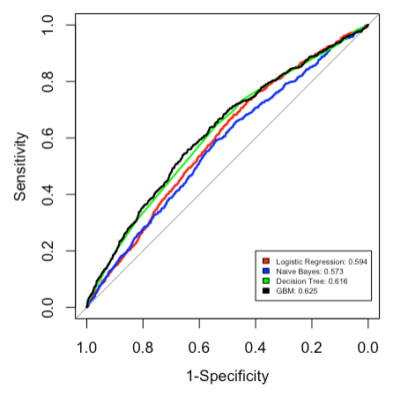
Result
ROC Curves Comparison
Best Model: *GBM* (From lift chart and ROC curves)
We omitted NA rows and condensed raw data to high correlated variations only for better comparison of models we chose.
We also tried other models like random forest and knn clusters but they don’t work well due to the nature of the dataset.
We will make our strategic decisions based on the evaluation of all 4 models and combining our findings.

Slide 6
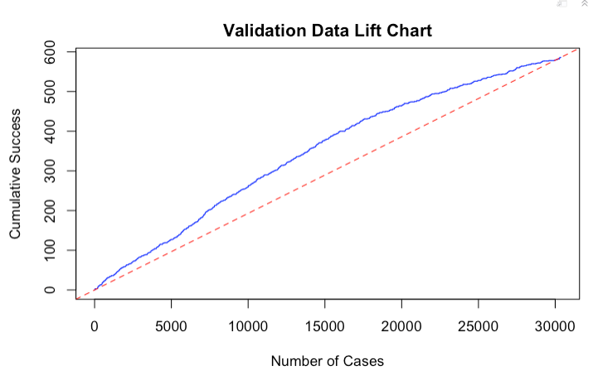
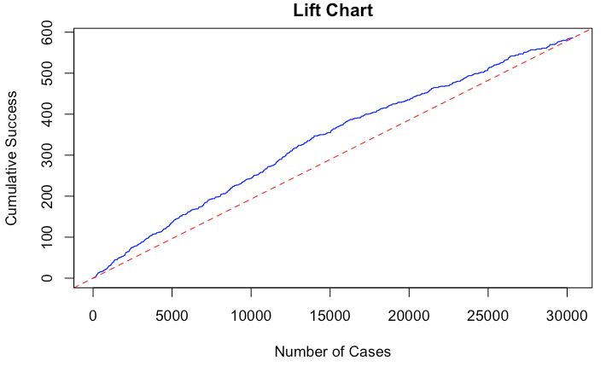
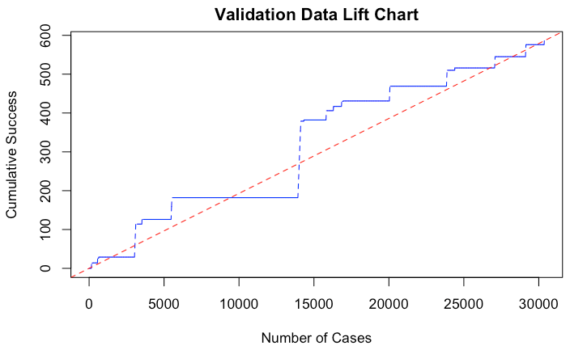
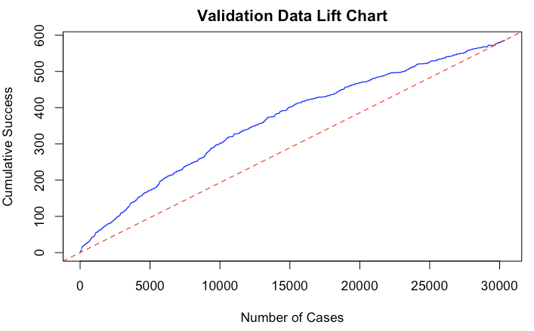

Logistic Regression
Naive Bayes
Decision Tree
GBM

Slide 7
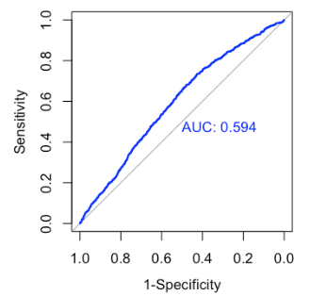
Logistic Regression
Model Development:
glm(CHURN~., data= train, family = "binomial")
Findings:
Class prediction on validation data set
Accuracy = 0.65
Sensitivity = 0.47
Specificity = 0.66
Variables that matter to the churn variable
EQPDAYS, WEBCAP, RETCALL, RECCHRGE and CREDITDE are statistically significant as their p-values are at least lower than 1.09e-05.
RECALLS and MOU are less significant as their p-values are higher than 0.05 (0.718 and 0.714 respectively).

Slide 8
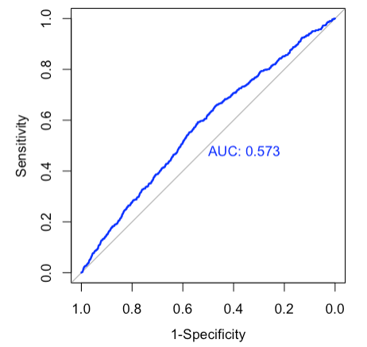

Naive Bayes
Model Development:
Naive Bayes(Churn~., data=train)
Class predictions on validation dataset:
MOU seems like the most influential factor to the churn rate.
Accuracy | 53%
Sensitivity | 59.73%
Specificity | 52.83%
Notes:
naiveBayes(CHURN~., data=train)

Slide 9
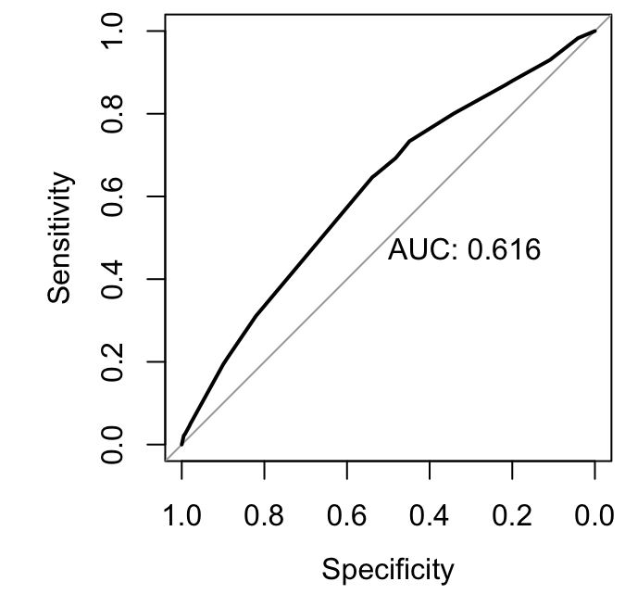
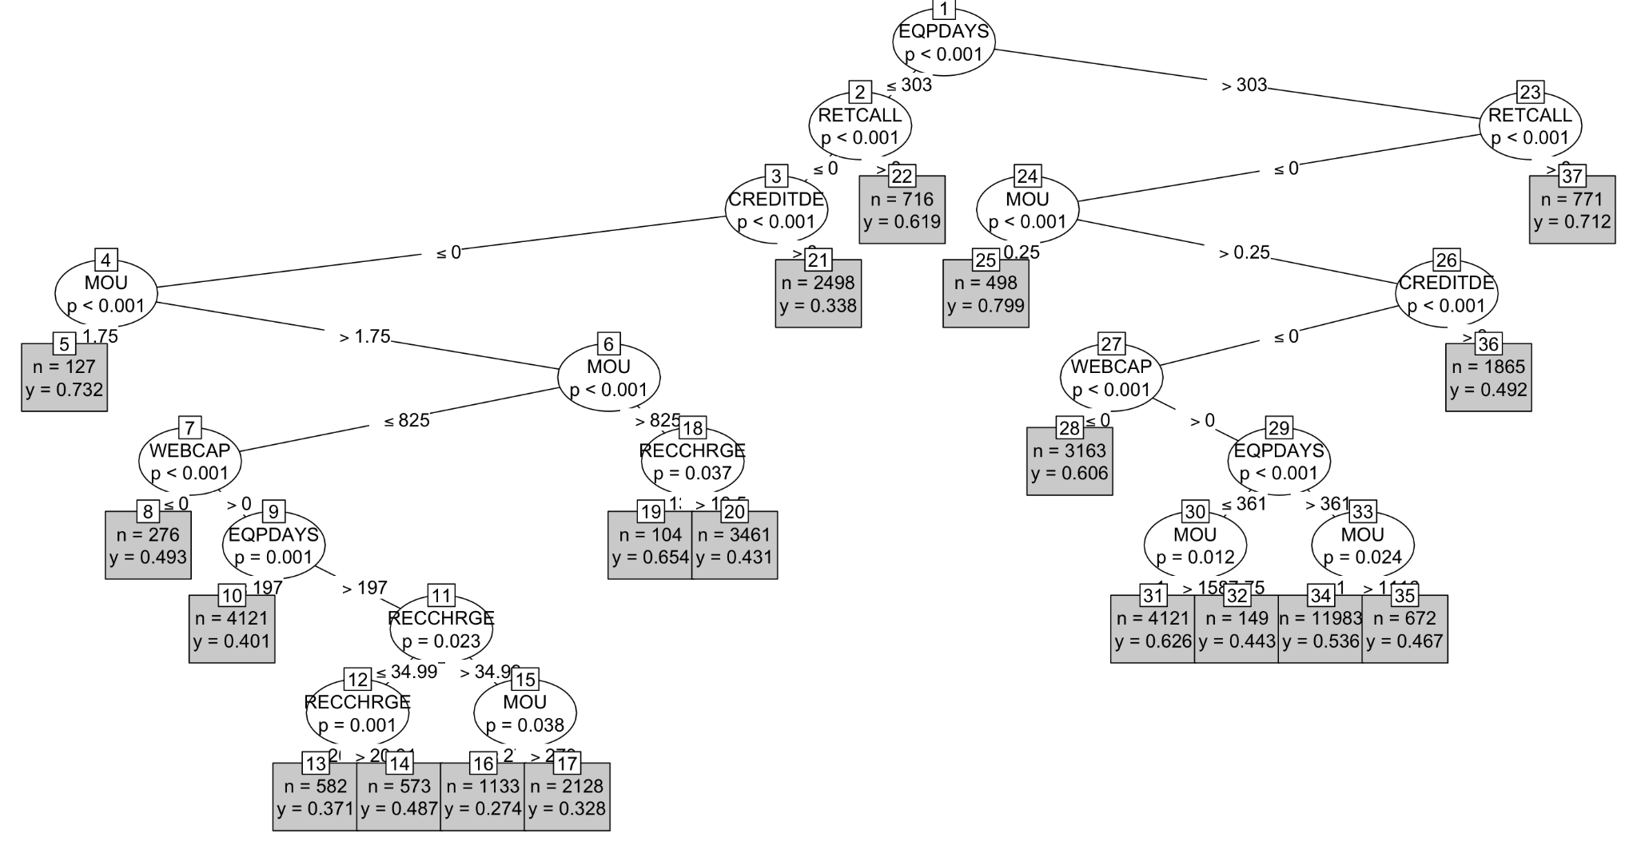
Decision Tree
Model Development:
tree<- ctree(CHURN ~ ., train)
Findings:
Variables that matter to the churn variable
EQPDAYS, MOU, RETCALL, WEBCAP and CREDITDE are key factors that matter to churn.

Slide 10
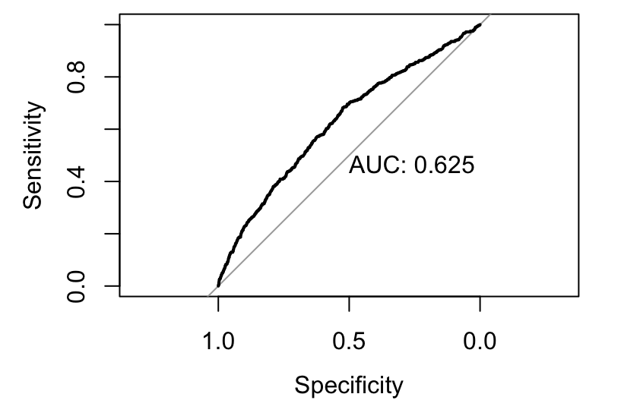
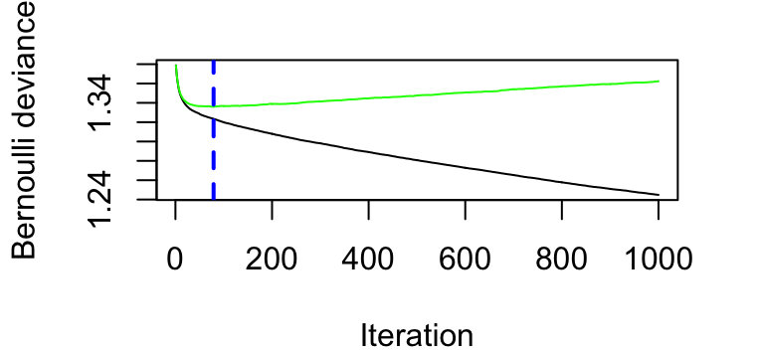
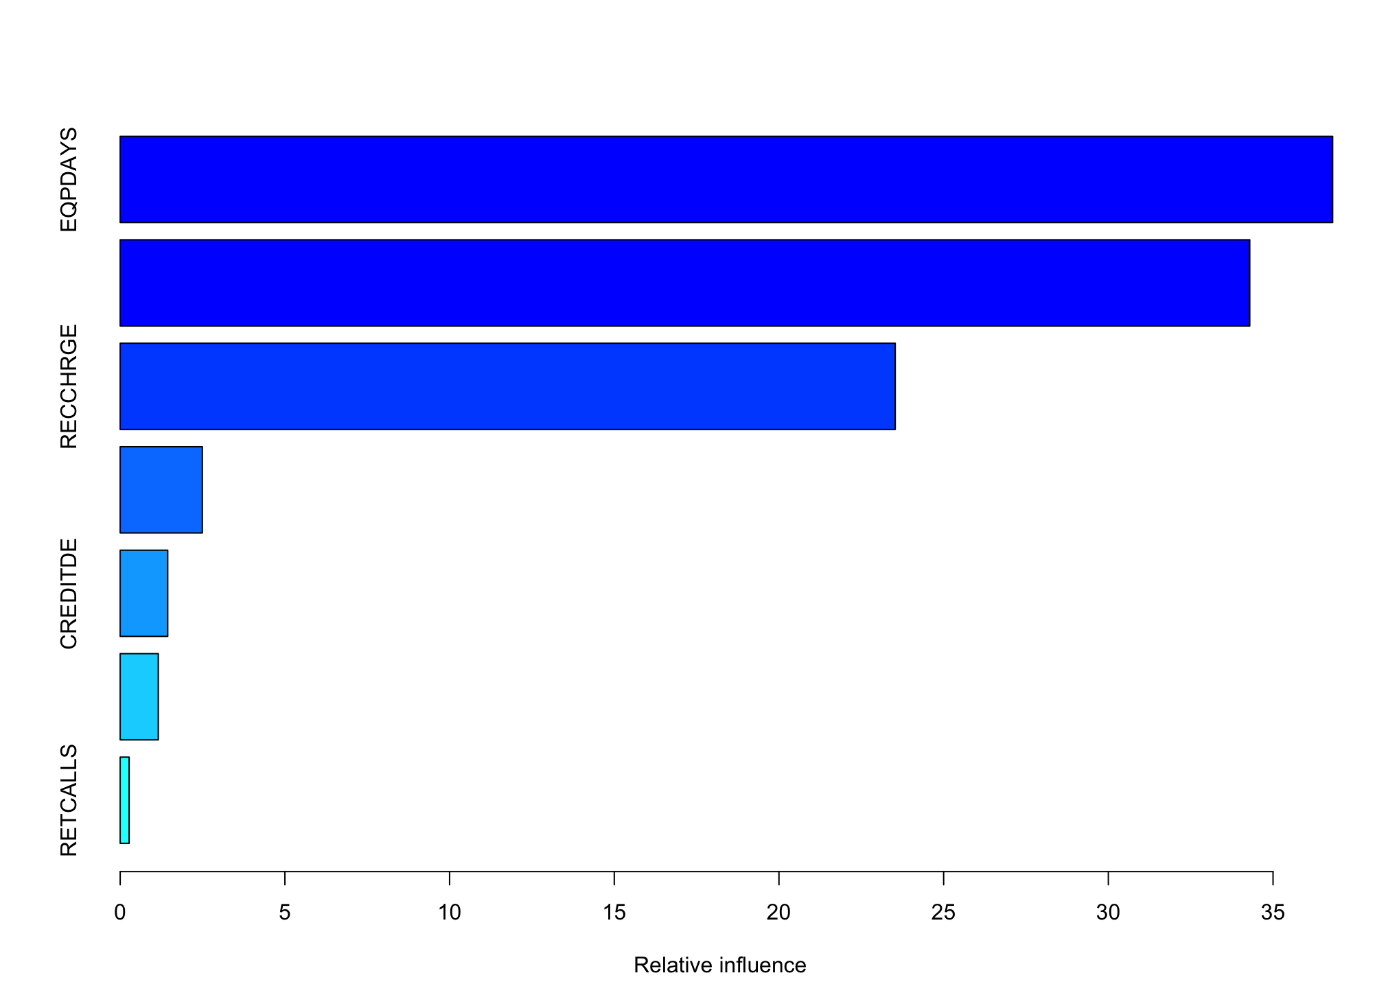
GBM Gradient Boosting Machine
Model Development:
gbm(CHURN~., data= train, distribution = "bernoulli", n.trees=1000, interaction.depth=6, cv.folds = 3)
Used the top correlation variables to build out the GBM model and fine tuned it to have 1000 n.trees, a default depth of 6, and perform 3 cross validation folds
Conducted an optimization to find optimal number of trees to use for the prediction model and found 78 trees to be optimal
Findings:
Scored a .625 AUC in the lift chart making it our best performing model
EQPDAYS, MOU, and RECCHRGE had the highest relative influence at 37.2, 35.3, and 22.5 respectively
CREDITDE, WEBCAP, RETCALLS had the weakest relative influence at 1.5, 1.2, and 0.2 respectively

Slide 11
Implications: Customer Retention Strategy
What incentive offers should be made to which customers to encourage them to remain with Cell2Cell?
Identify likely-to-churn customers early on and offer small promos to increase their usage.
Diversify added values and offerings relevant to their needs to increase customer satisfaction. (such as price tiers/more flexible subscription plans)
Offer equipment upgrade if they have used their devices for a long time.
No | Variable | Customers in the whole data set | Churned customers in validation data set
1 | Mean monthly minutes of use | 525.7 minutes | 446 minutes
2 | Mean total recurring charge | $46.9 | $42.66
3 | Number of days of the current equipment | 380 days | 416.5 days
Three main characteristics of the churned customers based on GBM model:
monthly minutes of use below the average;
recurring charge are below the average;
days of the current equipment is above the average

Slide 12
Future Predictions
How can one be sure that the actions recommended based on the predictive model will work?
We will need to collect future data on those likely-to-churn customers to feed the model and tuning the model.
Specifically, if the model predicts that group of customers will likely churn and the company offers some proactive retention promo offers, 2 months later, the company needs to compare the actual churn rate with the predicted churn rate to evaluate if the churn rate has improved.
If the churn rate is lower, the solutions apparently work but we need to monitor the whole program for a long period of time to fully evaluate the impacts of those retention programs.

